Slide 1
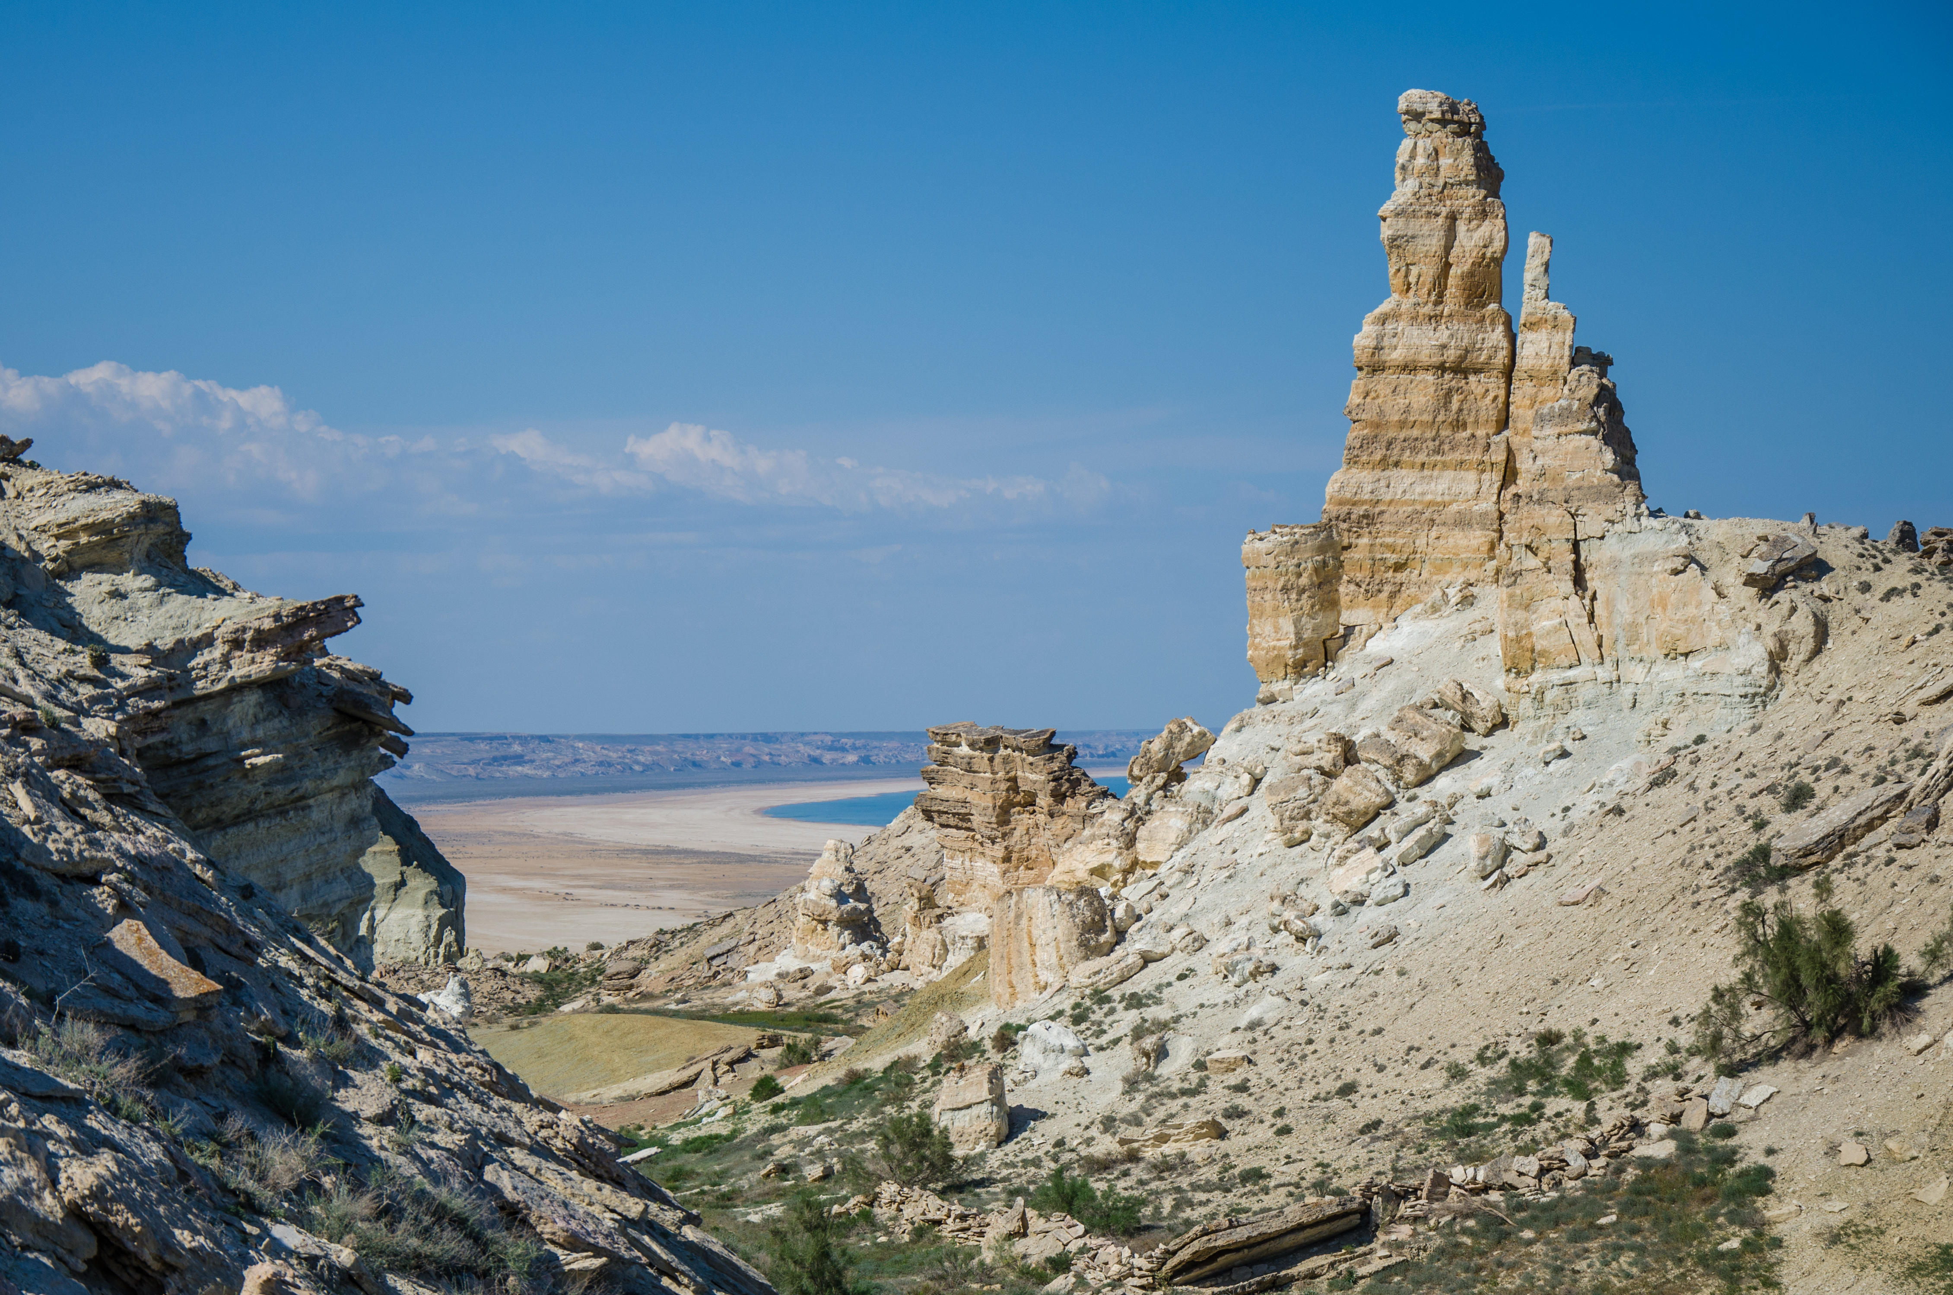


Full itinerary and detailed information about the trip.
Eco-Tour to the Aral Sea (3 days and 2 nights)
BEST CHOICE
BEST PRICES
RELIABLE TEAM

Slide 2

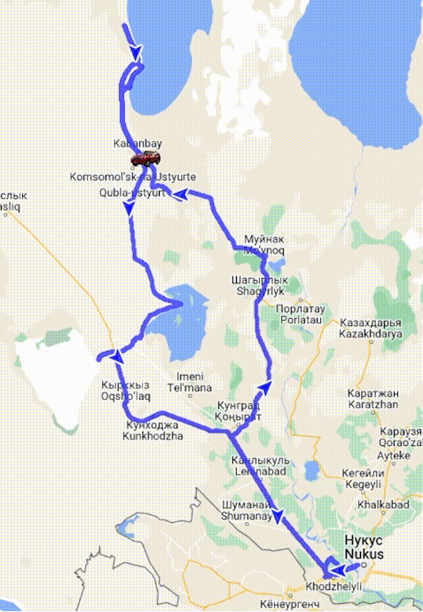
Trip itinerary
Duration:
3 days/2 night
Tour season:
Year-round
Total distance:
More than 900 km
Meals:
7 times
Transport:
Off-road vehicle 4x4

Slide 3

Day 1: Nukus - Muynak - Ustyurt Plateau - Aral Sea
Start point:
Nukus city (Railway Station, Airport, Hotel, etc.)
This tour promises unforgettable experiences, immersion in history and unique nature, as well as cozy nights in yurts. Visit the Aral Sea and its surroundings feeling the magic of this area.
09:00 Meeting with the driver and starting a unique journey to Muynak.
12:00 Arrival in Muynak. A visit to the cemetery of ships, and the museum of the Aral Sea, which presents the works of the artist F. Madgazina and R. Matevosyan captured on their canvases the greatness of the Aral Sea and the beauty of the Amu Darya River.
13:30 Lunch at the cozy Muynak guest house.
14:30 We continue along the dried-up bottom of the Aral Sea, you can capture a unique landscape with a photo camera. The steep ascent to the Ustyurt Plateau will be the beginning of a new extreme tour. Stop at the magnificent canyons of Ustyurt for a photo shoot.18:00 We arrive at the seashore and walk along the coastline, plunging into the atmosphere of this place.
19:00 Dinner at the yurt camp. A conversation in a friendly company. A night in cozy yurts immerses anyone in mysticism.
Day 2: Aral Sea - Kurgancha-kala - Nomads' Cemetery - Aktumsek Canyons - Camp by the Aral Sea
06:00 Early ascent will give you the opportunity to watch the amazing sunrise over the endless sea and gives the start of our excursion.
07:30-8:30 After breakfast, the tour starts from the Kurgancha Fortress. We mentally go back in time feeling the history of the Caravanserai on the Great Silk Road.
9:30 Stop at the cemetery of nomads. A guided tour of the descent from the Ustyurt Plateau down the trail, where you will plunge into the beauty created by nature surrounded by canyons resembling a sculpture park.
13:00 Lunch at Besqala Yurt Camp.
14:00 The tour continues to Cape Aktumsyk (15 km), walking through the picturesque places of Ustyurt: high canyons, Martian landscape, mysterious cave, and picturesque slabs, each of which is like pages of history. Then you can walk along the beach, swim in the sea, Return to the Bes ala yurt camp.
19:00 Dinner in a traditional style. After dinner, you can watch the stars through an open-air telescope, feeling the spirit of authenticity and romance of this place

Slide 4
Day 3: Aral Sea - Kubla-Ustyurt Village - Barsakelmes Salt Lake - Suochi Lake - Kungrad - Khodjeli - Nukus
06:00 Early rising to meet the dawn, which painted the sea in delicate shades.
08:00 After breakfast, our way goes to the village of Komsomolsk Kubla Ustyurt.
09:30 Against the background of the village landscape, you can capture camels, horses on a photo camera, walk along the abandoned runway and try camel milk from the locals and immerse yourself in the authenticity of this place.
11:00 Arrival at Sudochie Lake, a former part of the Aral Sea, where numerous migratory birds nest, including pink flamingos. This place is a real paradise for fans of wildlife watching.
12:30 p.m. The journey will continue to the Barsakelmes salt marsh, a huge salt lake (analogous to Salar de Uyuni - salt marsh in Bolivia), left over from the ancient Tethys Ocean. Here you will have the opportunity to create unique photos, immersing yourself in incredible views of nature.
14:30 Lunch at the Naiman roadside cafe.
16:30 On the way you will pass through the Kungrad and Khojaly districts, which played an important role during the Great Silk Road. Tour of the Mizdakhkan necropolis in the Khojaly district. The ruins of the necropolis will allow you to experience the history of the mausoleum of Mazlumkhan Sulu (XII-XIV centuries), Jumart kassab hill, Shamun Nabi (XII century), Khalifa Yerezhep and Gaur Kala (VI century BC - IX century AD).
18:30 Arrival in the city of Nukus,. The end of the tour.

Slide 5
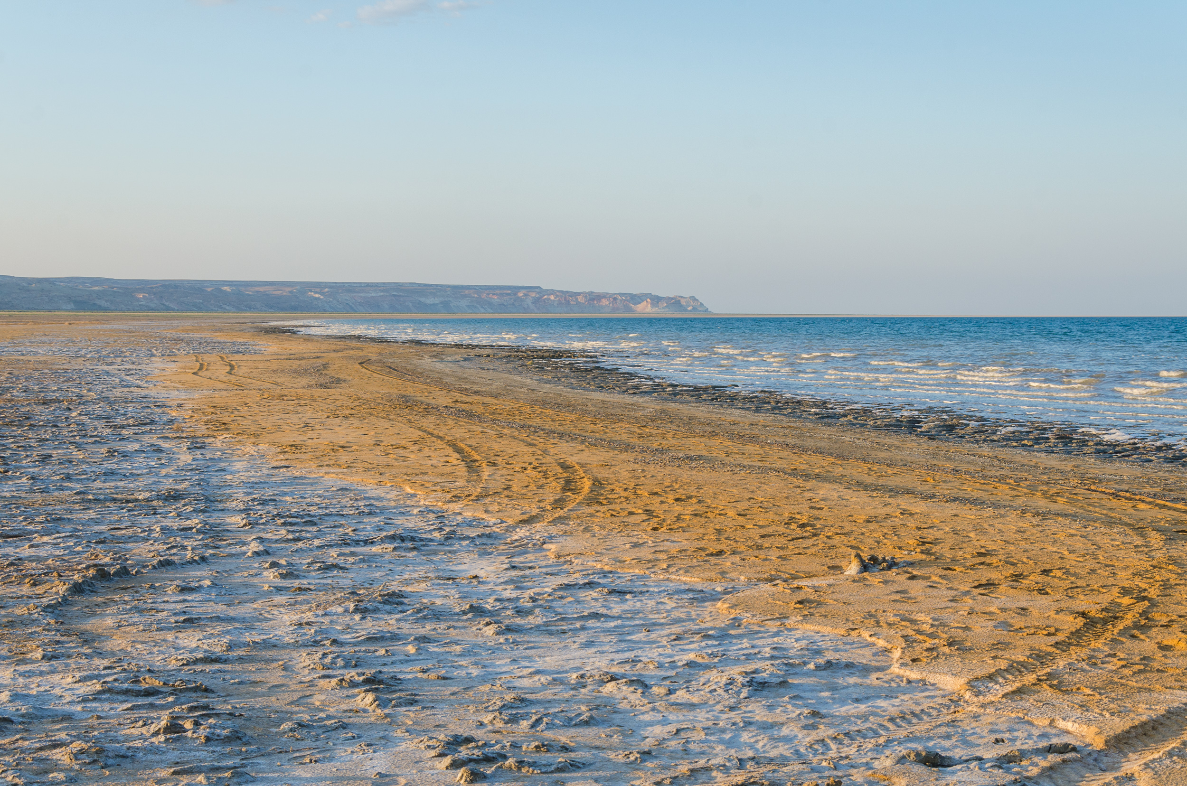
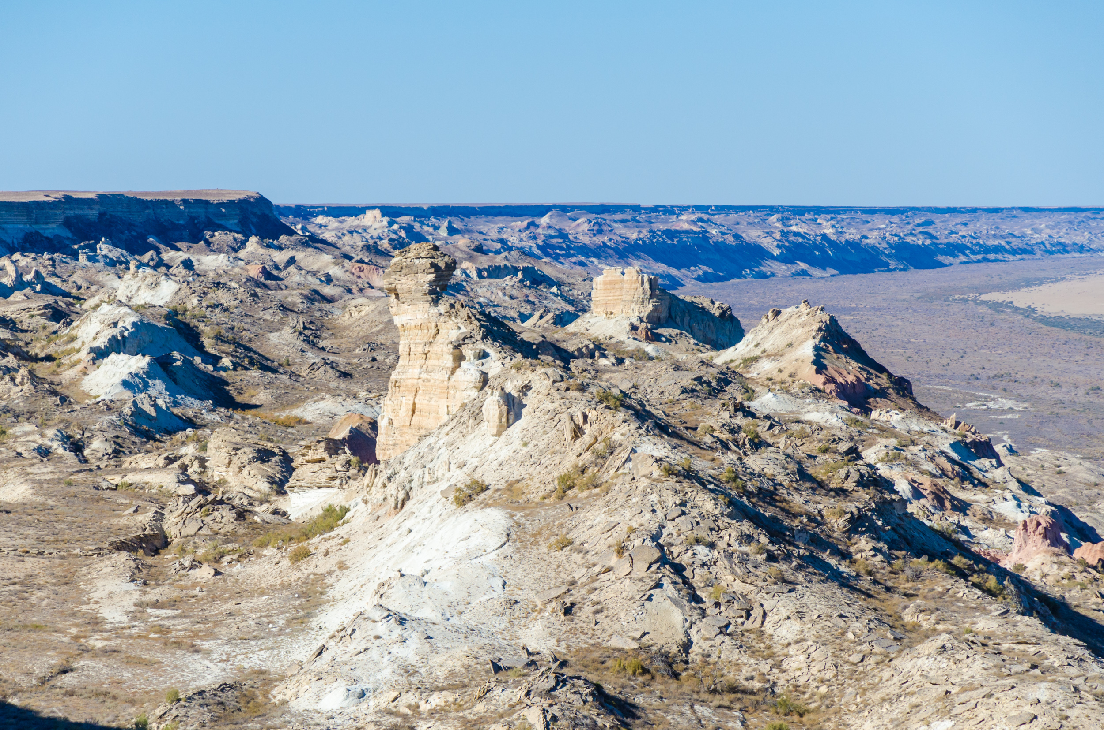
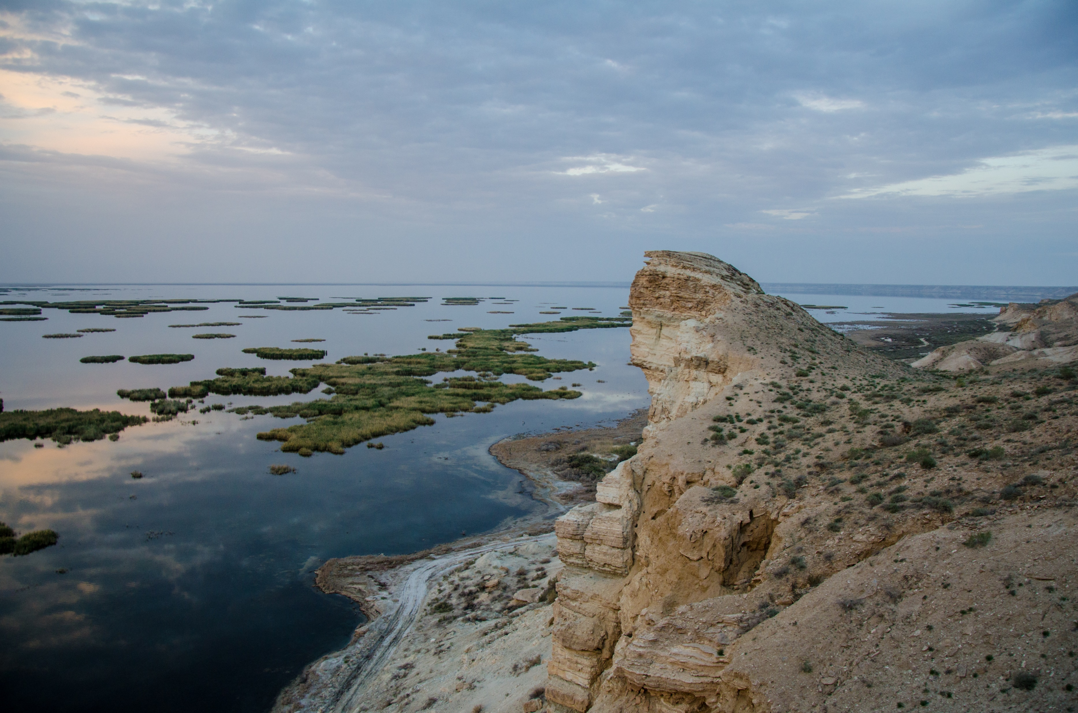
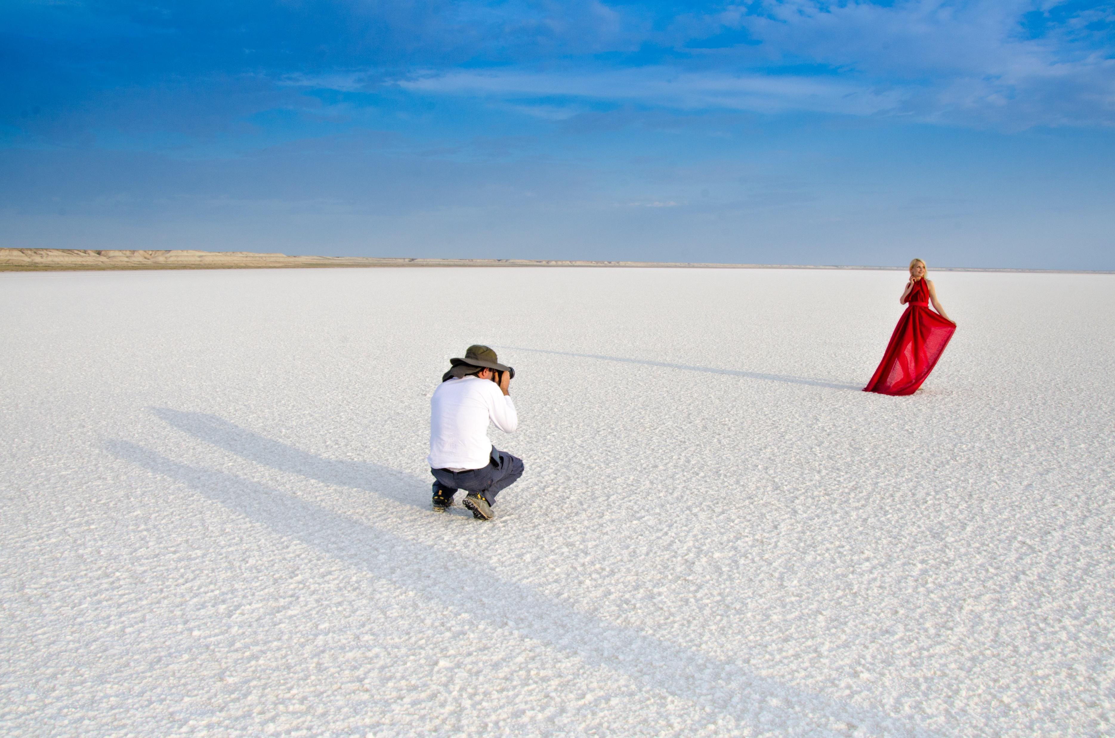
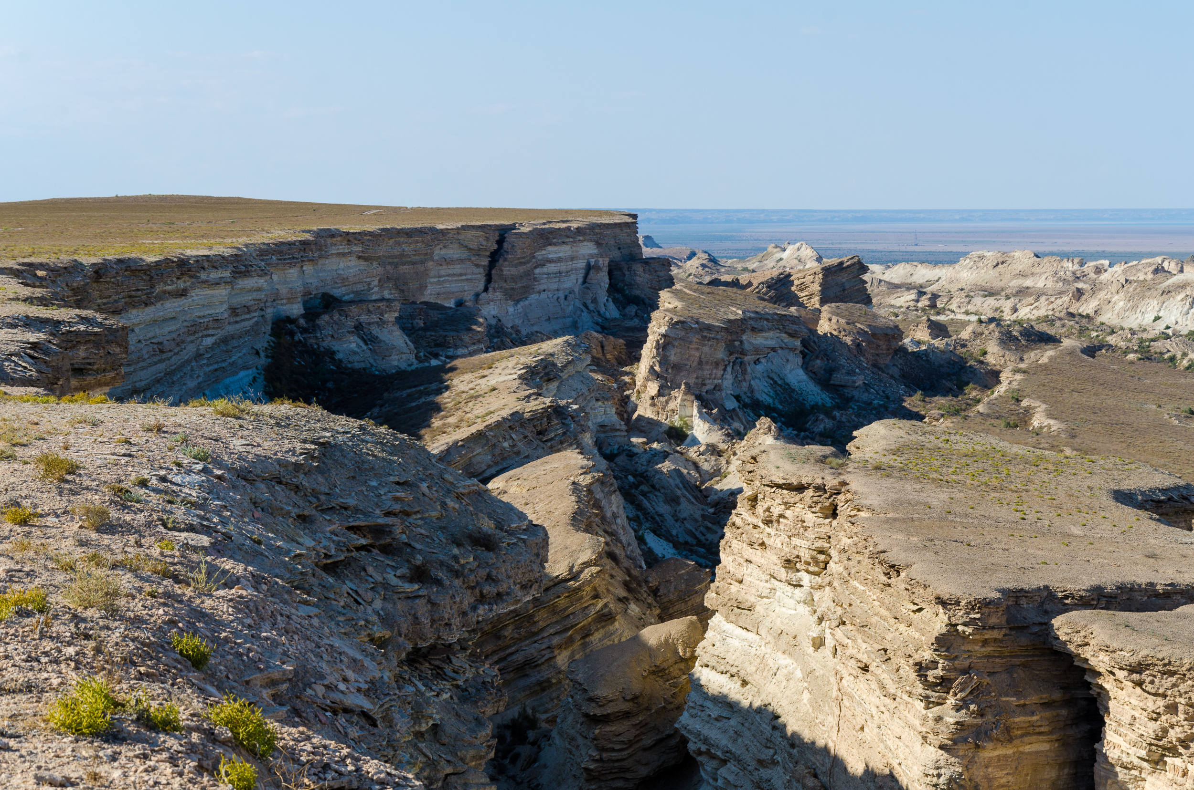
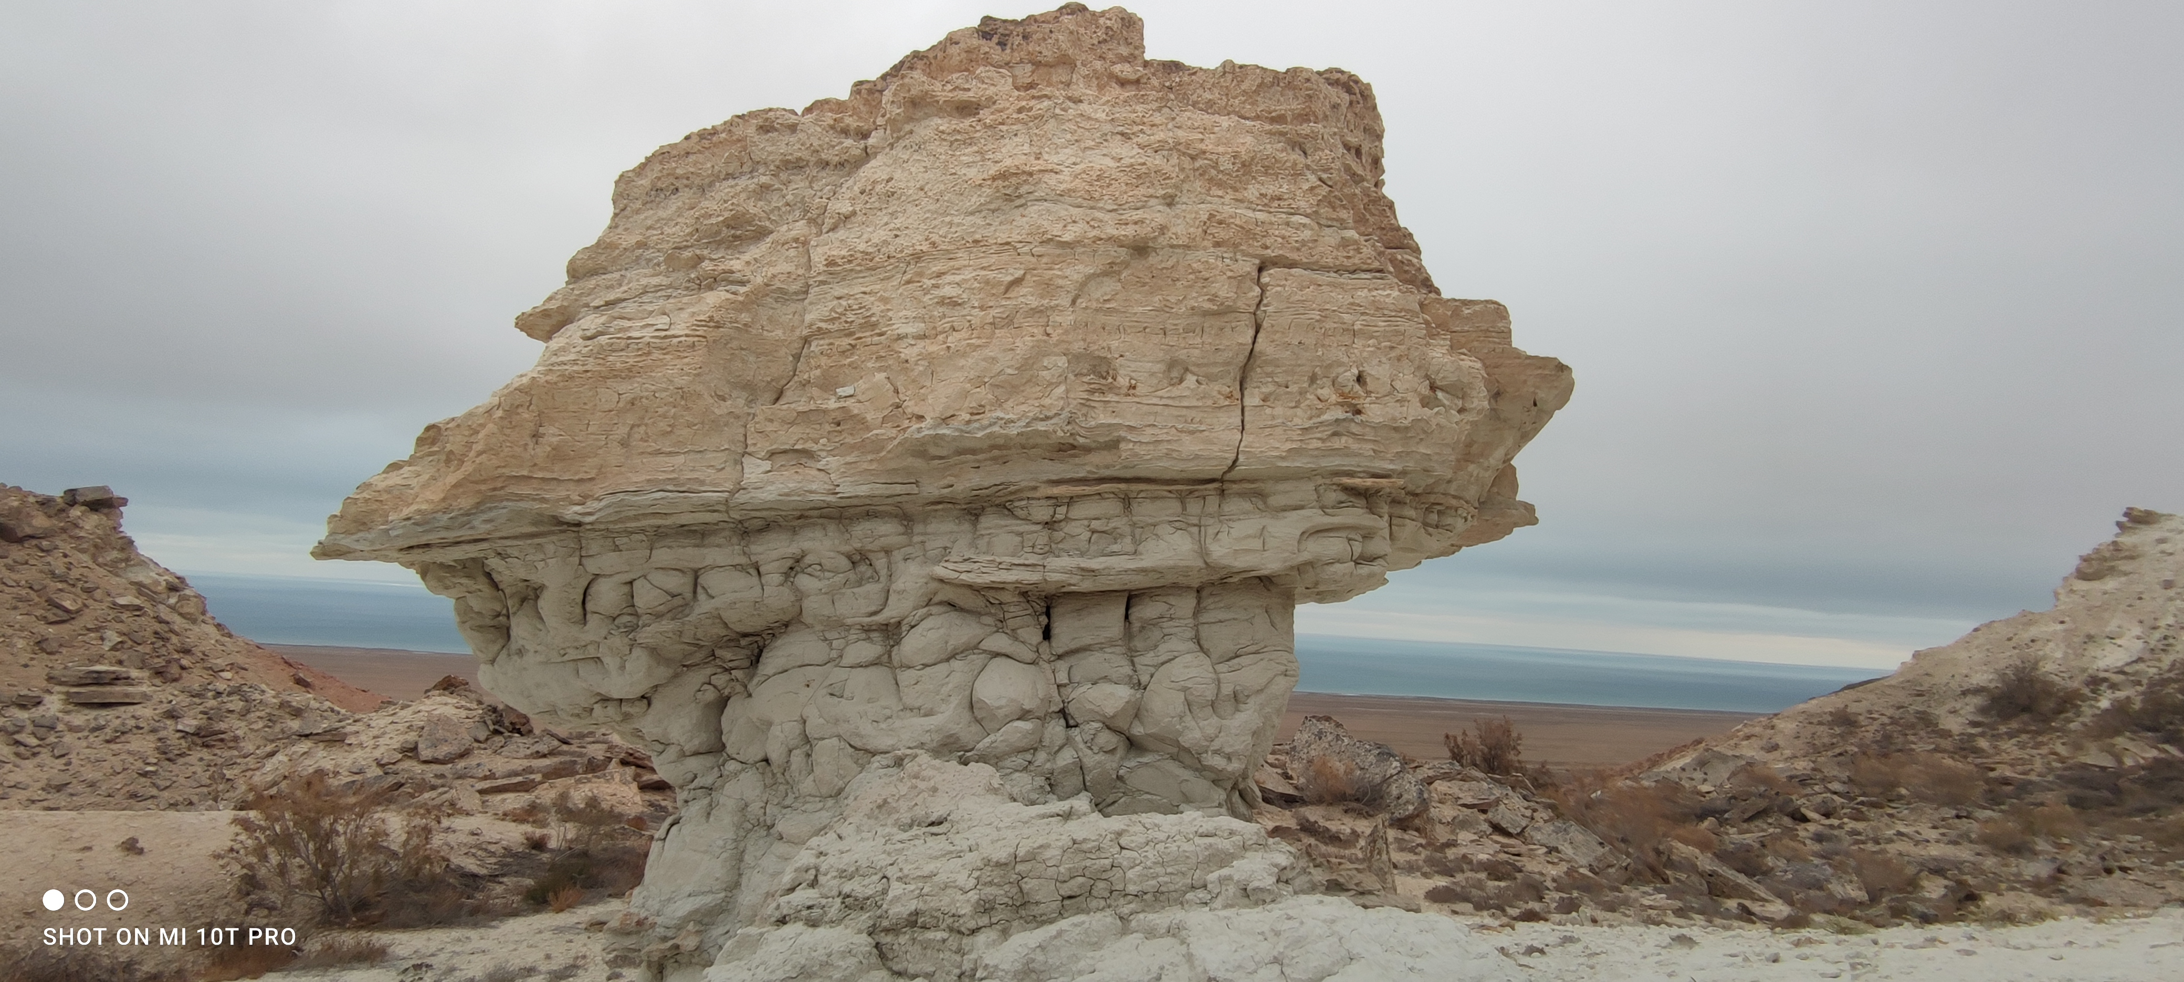
www.besqala.com

Slide 6
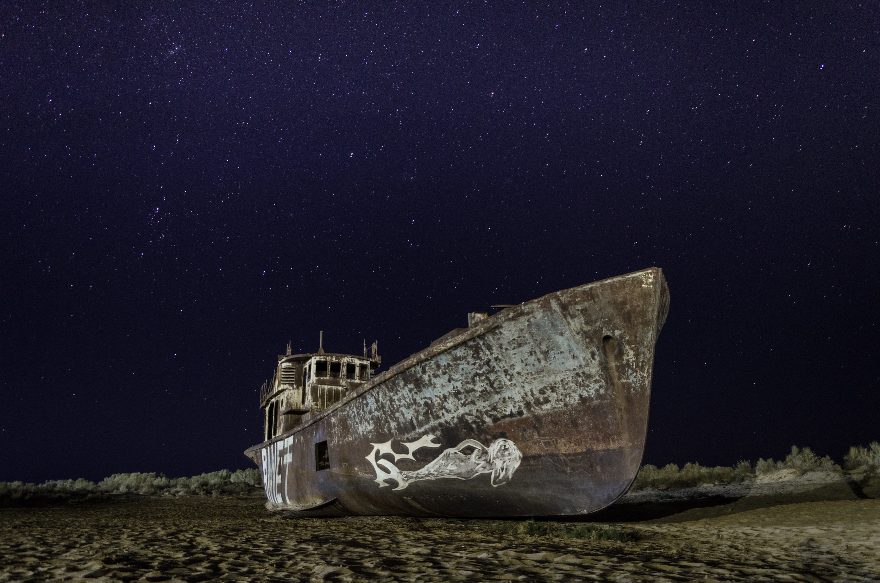
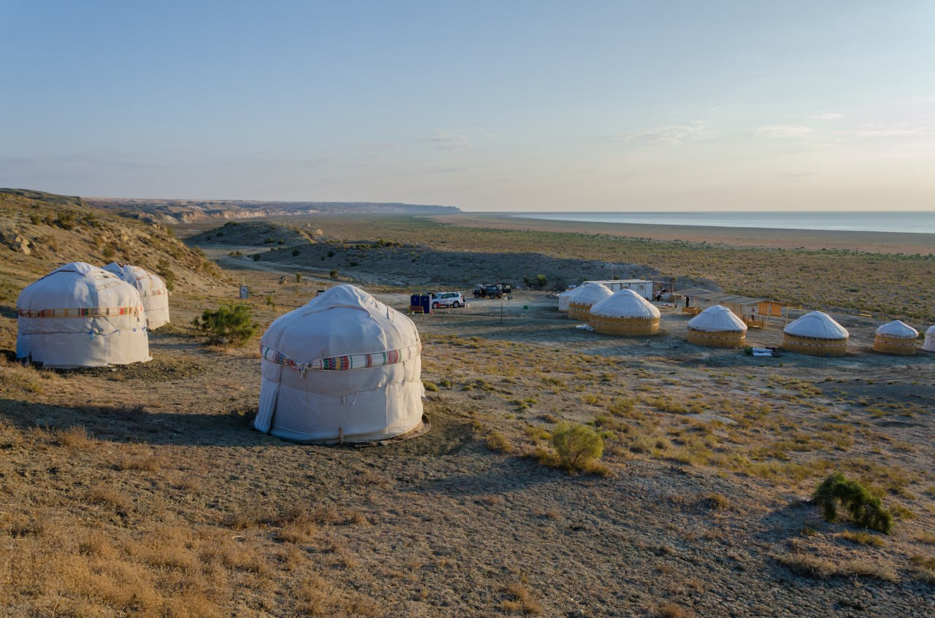
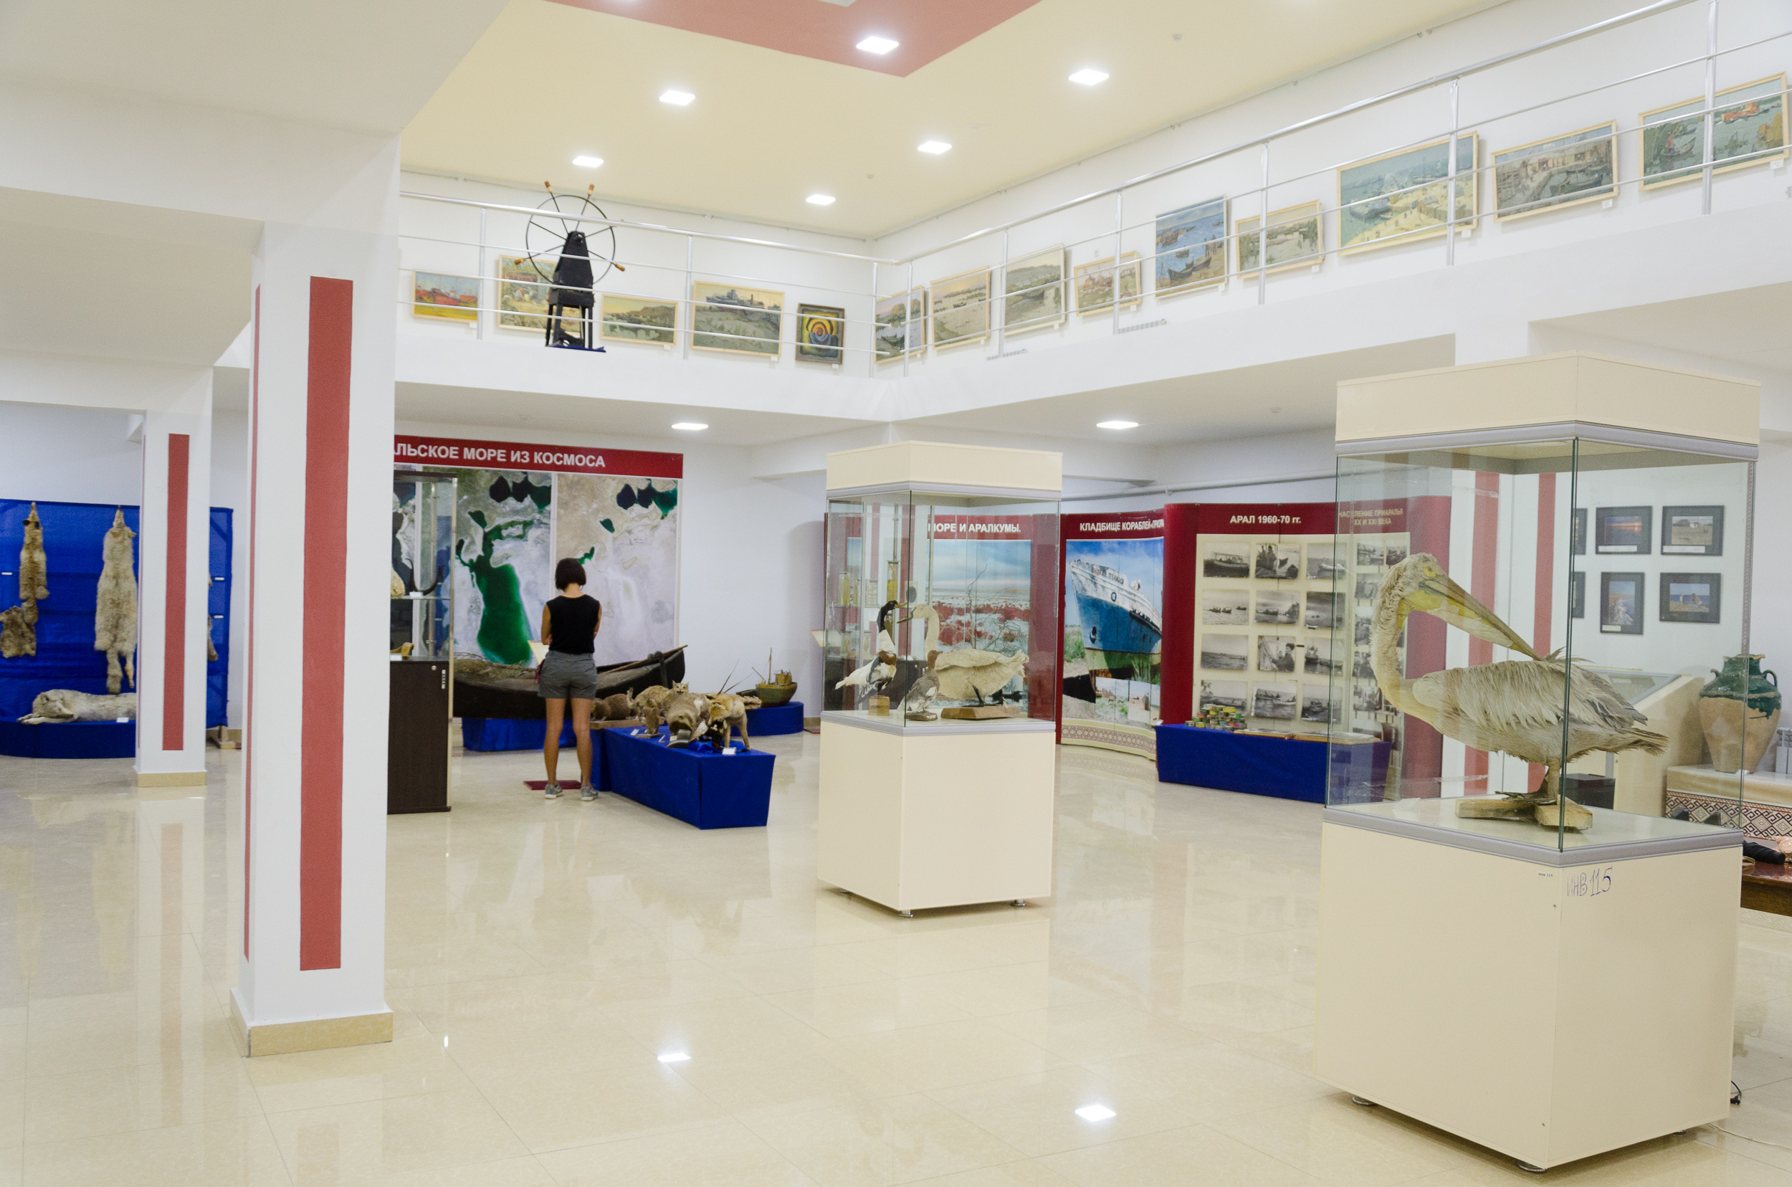
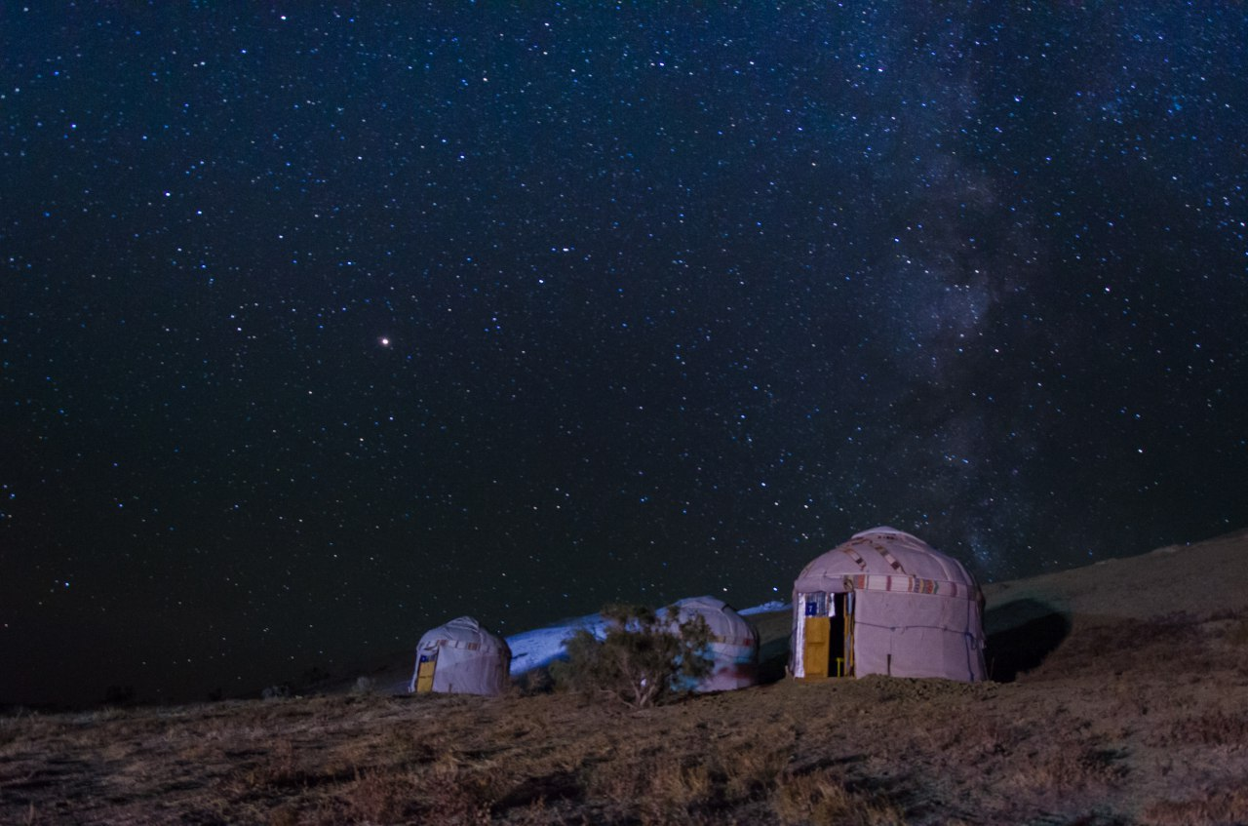
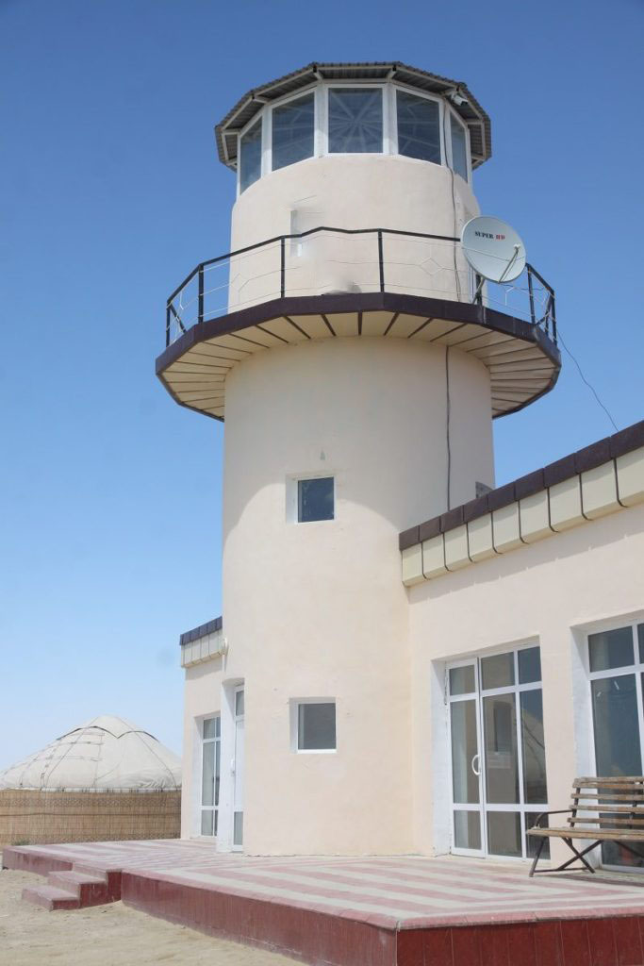
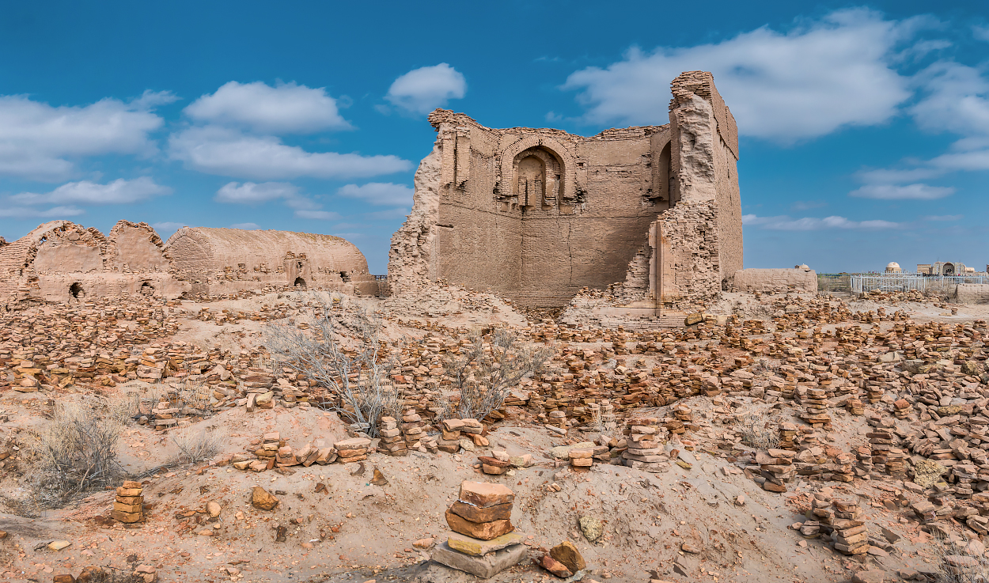
www.besqala.com

Slide 7
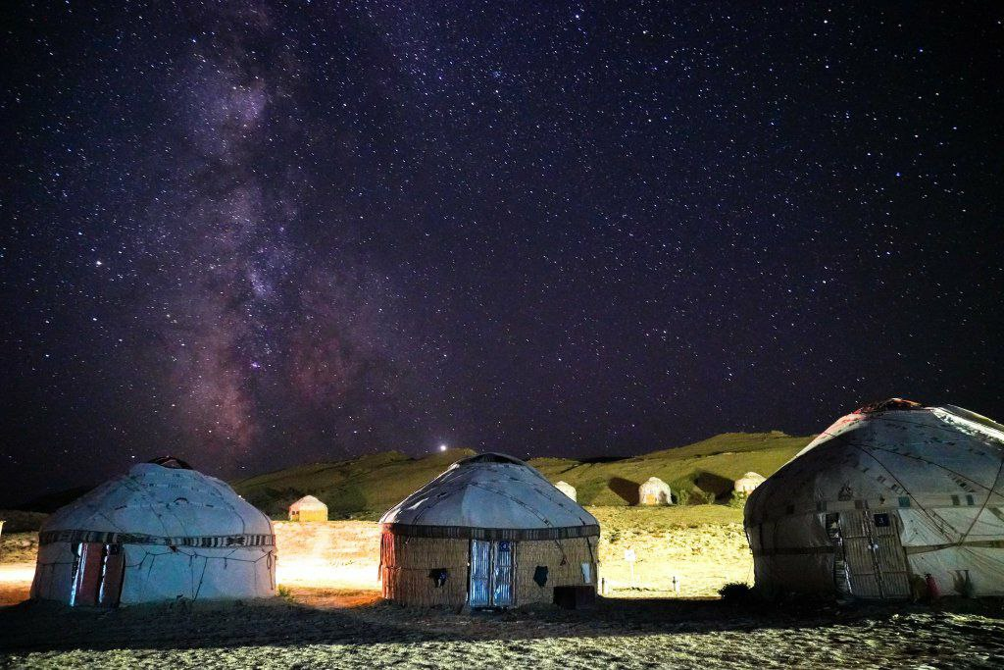
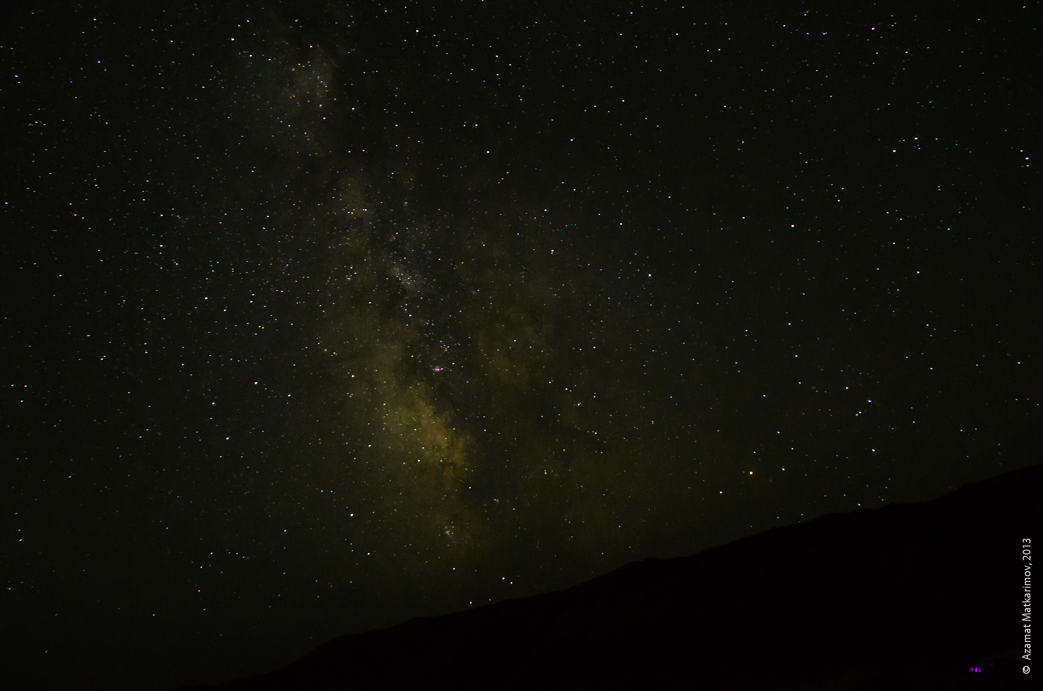
www.besqala.com

